Slide 1
Cost Optimization Case Study
Vendor Negotiation | Market Benchmarking | TCO Analysis | Cost-Saving Strategies

Slide 2
Executive Summary
Objective: Optimize procurement costs while maintaining quality.
Scope: Hardware suppliers including OEMs.
Approach: Negotiation, Benchmarking, TCO Analysis, Strategic Savings.
Outcome: Achieved 15% cost reduction and improved supplier reliability.

Slide 3
Vendor Negotiation Scenario: Volume Discounts
Description of Volume Discounts:
Benefits: Cost reduction, risk mitigation.
Risks: Supplier lock-in, dependency.
Strategy: Align with long-term procurement goals.

Slide 4
Vendor Negotiation Scenario: Multi-Year Contracts
Description of Multi-Year Contracts:
Benefits: Cost reduction, risk mitigation.
Risks: Supplier lock-in, dependency.
Strategy: Align with long-term procurement goals.

Slide 5
Vendor Negotiation Scenario: Bundled Services
Description of Bundled Services:
Benefits: Cost reduction, risk mitigation.
Risks: Supplier lock-in, dependency.
Strategy: Align with long-term procurement goals.

Slide 6
Vendor Negotiation Scenario: Performance-Based Incentives
Description of Performance-Based Incentives:
Benefits: Cost reduction, risk mitigation.
Risks: Supplier lock-in, dependency.
Strategy: Align with long-term procurement goals.

Slide 7
Market Benchmarking Criteria
Price comparison across OEMs
Quality certifications
Delivery performance
Warranty and support terms

Slide 8
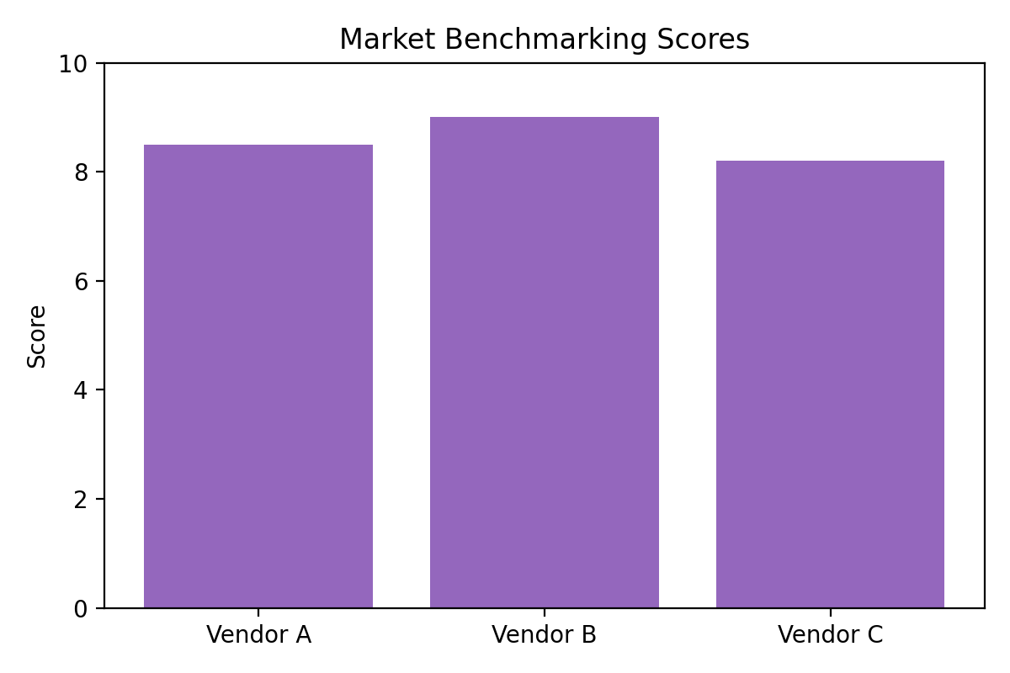
Benchmarking Scores

Slide 9
TCO Analysis Components
Initial Purchase Cost
Maintenance and Support
Energy Consumption
End-of-Life Disposal

Slide 10
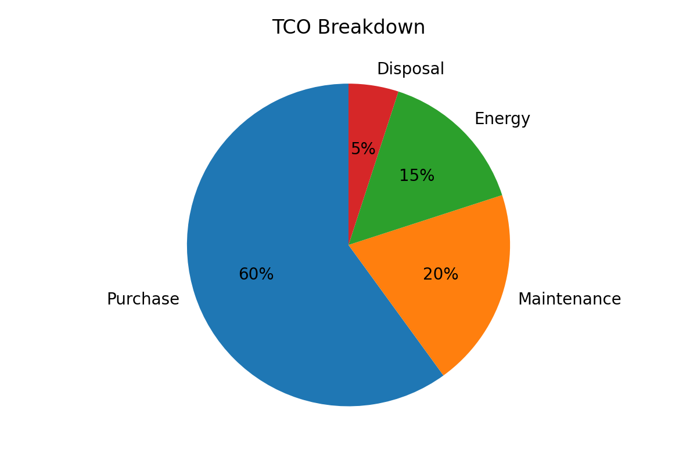
TCO Breakdown

Slide 11
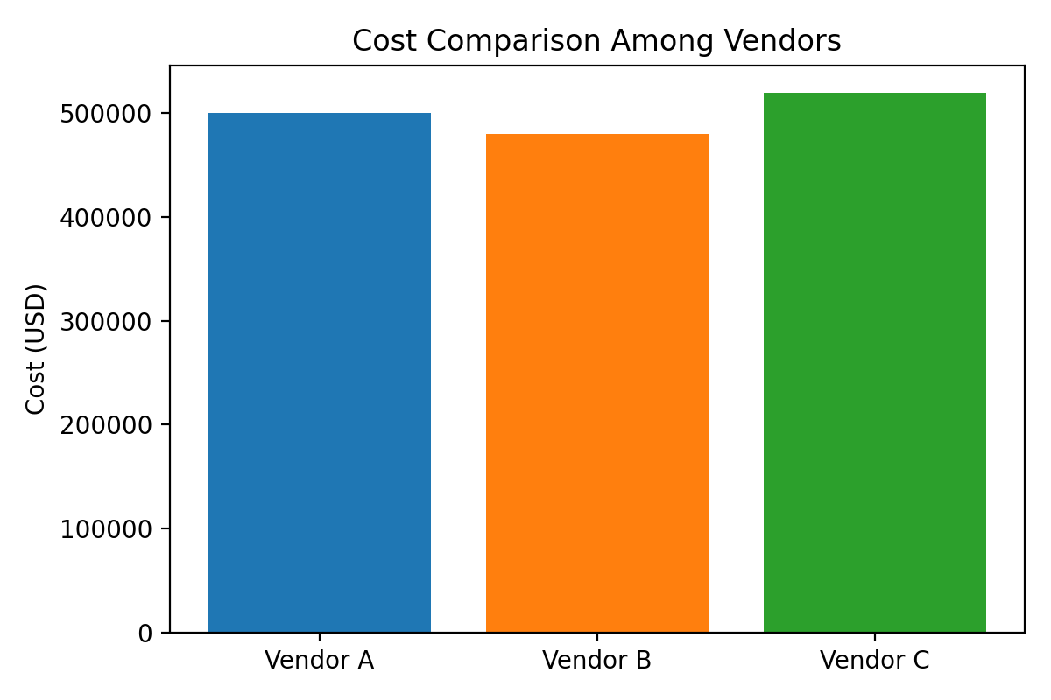
Cost Comparison

Slide 12
Cost-Saving Strategies: Short-Term
  Renegotiate contracts
  Consolidate orders
  Inventory control

Slide 13
Cost-Saving Strategies: Long-Term
  Strategic partnerships
  Supplier development
  Digital procurement platforms

Slide 14
Strategic Recommendations
Focus on reliable suppliers with competitive TCO
Regular benchmarking updates
Integrate sustainability into procurement

